Slide 1
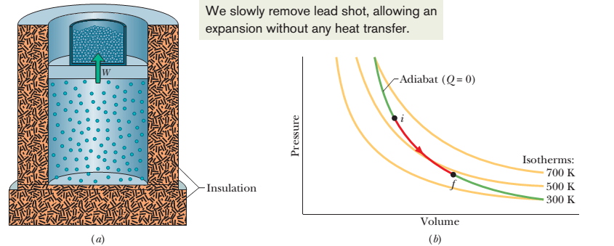
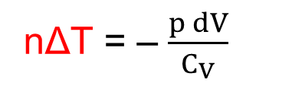
Lesson 8
Chapter 19: The Kinetic Theory of Gases
19-9 Adiabatic expansion of an ideal gas: p$V^{γ}$= a constant
adiabatic process, Q = 0
Suppose that you remove some shots from the piston, allowing the ideal gas to push the piston and the remaining shots upward and thus to increase the volume by a differential amount dV. Since the volume change is tiny, we may assume that the pressure p of the gas on the piston is constant during the change. The work dW done by the gas during the volume increase is equal to W = p dV.
1st law of thermodynamics, ΔE_{int} = Q – W
nC_{V} ΔT = 0 – p dV
nΔT = – $\frac{p dV}{C_{V}}$
[ΔE_{int} = Q – W = nC_{V} ΔT – pΔV = nC_{V} ΔT– p(V – V) = nC_{V} ΔT– p(0) = nC_{V} ΔT]

Slide 2
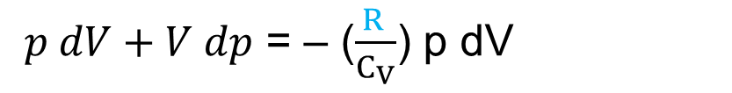
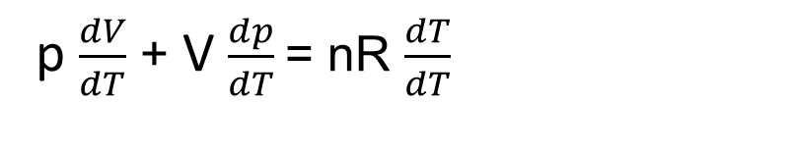
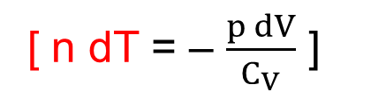
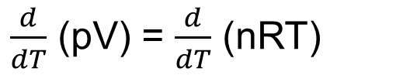
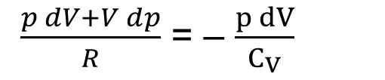
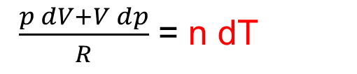
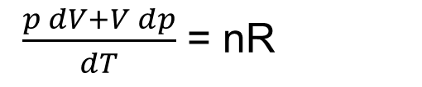
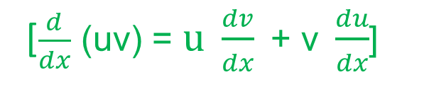
Ideal gas equation, pV = nRT
$\frac{d}{dT}$ (pV) = $\frac{d}{dT}$ (nRT)
[$\frac{d}{dx}$ (uv) = $\text{u} \frac{dv}{dx}\text{ + }\text{v} \frac{du}{dx}$]
p $\frac{dV}{dT}$ + V $\frac{dp}{dT}$= nR $\frac{dT}{dT}$
$\frac{p dV+V dp}{dT}$ = nR
$\frac{p dV+V dp}{R}$ = n dT
$\frac{p dV+V dp}{R}$ = – $\frac{p dV}{C_{V}}$
[ n dT = – $\frac{p dV}{C_{V}}$ ]
$p dV+V dp$ = – ($\frac{R }{C_{V}}$) p dV
[C_{p} – C_{V} = R]

Slide 3

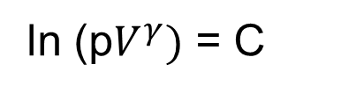
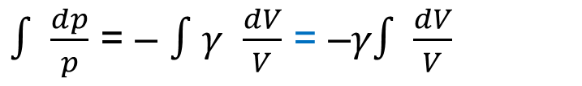

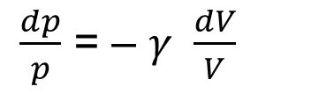
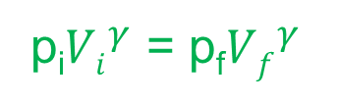
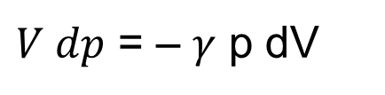
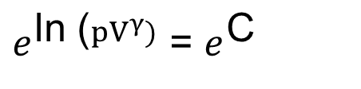
$p dV+V dp$ = – ($\frac{\text{C}\text{p}\text{ – }\text{C}\text{V}}{C_{V}}$) p dV = – ($\frac{\text{C}\text{p} }{C_{V}}$ $\text{–}$ 1) p dV = – ($γ$ $\text{–}$ 1) p dV = – 𝛾 p dV + p dV
$V dp$ = – 𝛾 p dV
$\frac{dp}{p}$ = – 𝛾 $\frac{dV}{V}$
[$divided by pV]$
$∫$ $\frac{dp}{p}$ = – $∫$𝛾 $\frac{dV}{V}$ = –𝛾$∫$ $\frac{dV}{V}$
ln p + C₁= - 𝛾 ln V + C₂
ln p + 𝛾 ln V = C
ln p + ln $V^{γ}$ = C
ln (p$V^{γ})$ = C
$e^{\text{ln}\text{ (}pV^{γ})}$ = $e^{\text{C}}$
p$V^{γ}$ = a constant [adiabatic expansion or contraction]
p_{i}${Vi}^{γ}$ = p_{f}${Vf}^{γ}$

Slide 4
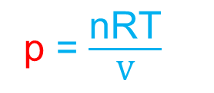

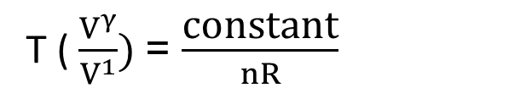
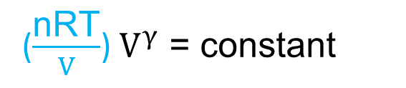
19-9 T$V^{γ−1}$ = constant for an adiabatic process:
For an adiabatic process, p$V^{γ}$ = constant
To write an equation for an adiabatic process in terms of T and V, we use the ideal gas equation to eliminate p
Ideal gas equation, pV = nRT
p = $\frac{\text{nRT}}{V}$
($\frac{\text{nRT}}{V}$) $V^{γ}$ = constant
T ( $\frac{V^{γ}}{V^{1}})$= $\frac{\text{constant}}{nR}$
[n and R are constants]
T$V^{γ−1}$ = constant
When the gas goes from an initial state i to a final state f: T_{i}${Vi}^{γ−1}$ = T_{f}${Vf}^{γ−1}$

Slide 5
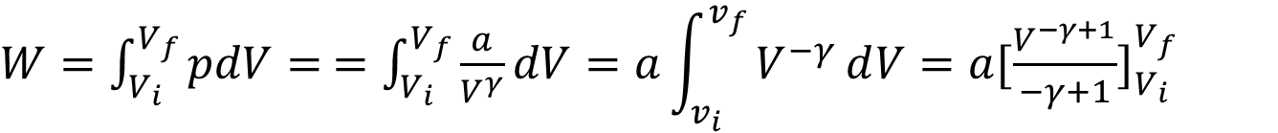
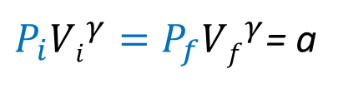
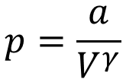
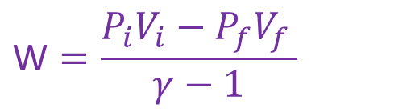
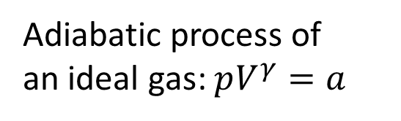
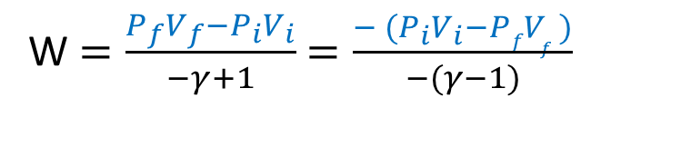
19-9 W$ork done for an ideal gas in an adiabatic process: W=\frac{P_{i}V_{i}−P_{f}V_{f}}{γ−1}$
$W=\int_{V_{i}}^{V_{f}}{pdV}=$ $=\int_{V_{i}}^{V_{f}}{\frac{a}{V^{γ}}dV}=a\int_{v_{i}}^{v_{f}}{V^{−γ}ⅆV=a{[\frac{V^{−γ+1}}{−γ+1}]}_{V_{i}}^{V_{f}}}$
Adiabatic process of
an ideal gas: $pV^{γ}=a$
$W=\frac{a}{−γ+1}$ ${[V^{−γ+1}]}_{V_{i}}^{V_{f}}$ $=\frac{a}{−γ+1}$($V_{f}^{−γ+1}$- $V_{i}^{−γ+1}$) $=\frac{{aV}_{f}^{−γ+1}\text{− }{aV}_{i}^{−γ+1}}{−γ+1}$
$$p=\frac{a}{V^{γ}}$$
$P_{i}{Vi}^{γ}=P_{f}{Vf}^{γ}$= a
$W=\frac{{aV}_{f}^{−γ+1}\text{− }{aV}_{i}^{−γ+1}}{−γ+1}$ $=\frac{{P_{f}{Vf}^{γ}V}_{f}^{−γ+1}\text{− }{P_{i}V_{i}V}_{i}^{−γ+1}}{−γ+1}$ $=\frac{{P_{f}V}_{f}^{γ−γ+1}\text{− }{P_{i}V}_{i}^{γ−γ+1}}{−γ+1}$
W $=\frac{P_{f}V_{f}−P_{i}V_{i}}{−γ+1}$ $=\frac{{− (P}_{i}V_{i}−PfV_{f })}{−(γ−1)}$
$$\text{W}=\frac{P_{i}V_{i}−P_{f}V_{f }}{γ−1}$$

Slide 6
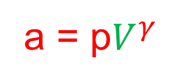

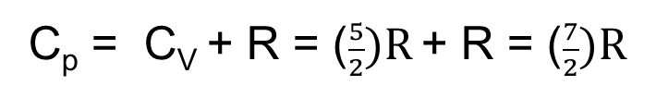



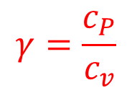

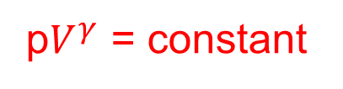
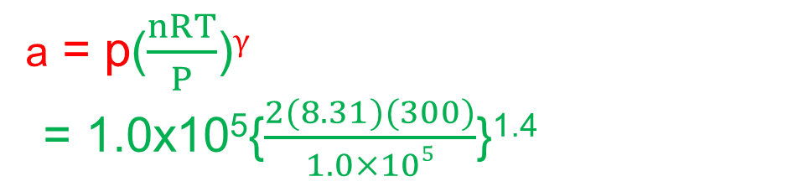
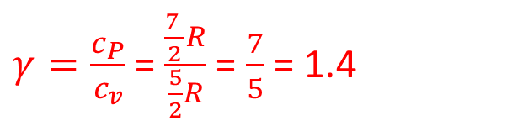
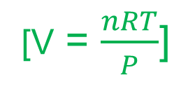
54. We know that for an adiabatic process pV^{γ} = a constant. Evaluate “a constant” for an adiabatic process involving exactly 2.0 mol of an ideal gas passing through the state having exactly p = 1.0 atm and T = 300 K. Assume a diatomic gas whose molecules rotate but do not oscillate.
Solution:
p$V^{γ}$ = constant
Here, n = 2 mol
T = 300 K
a = p$V^{γ}$
P = 1.0 atm = 1.0x10⁵ Pa
[Ideal gas law, pV = nRT]
a = p($\frac{nRT}{P}$)$γ$
= 1.0x10⁵{$\frac{2(8.31)(300)}{1.0×105}$}^{1.4}
p$V^{γ}$ = constant
$$γ=\frac{c_{P}}{c_{v}}$$
[V = $\frac{nRT}{P}$]
Diatomic gas whose molecules rotate
but do not oscillate, f = 3+2 = 5
= 1.0x10⁵{0.04986}^{1.4}
C_{V} = ($\frac{f}{2})R=$ ($\frac{5}{2})R$
a =1.5x10³ Nm^{2.2}
C_{p} – C_{V} = R
C_{p} = C_{V} + R = ($\frac{5}{2})R$ + R = ($\frac{7}{2})R$
Unit of a = p$V^{γ}$ = ($\frac{N}{m^{2}}$)($m^{3}$)$γ$
$=Nm^{3γ−2}$ = $Nm^{3\left(1.4\right)−2 }$
$γ=\frac{c_{P}}{c_{v}}$ =$\frac{\frac{7 }{2}R}{\frac{5}{2}R}$ = $\frac{7}{5}$ = 1.4
a = $Nm^{2.2}$

Slide 7
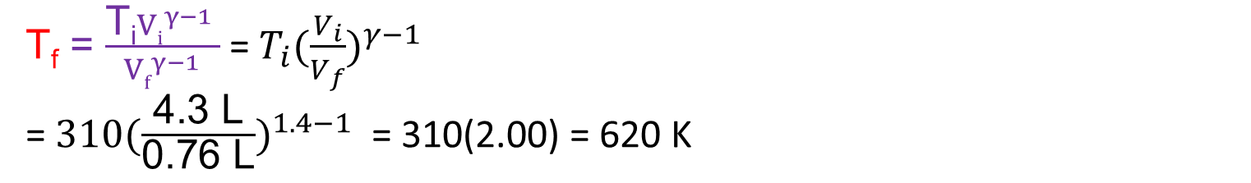
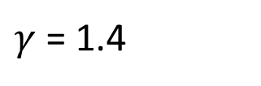
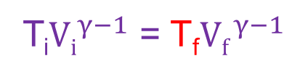

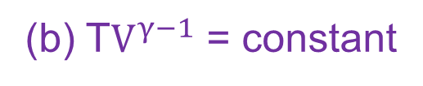
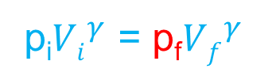
55. A certain gas occupies a volume of 4.3 L at a pressure of 1.2 atm and a temperature of 310 K. It is compressed adiabatically to a volume of 0.76 L. Determine (a) the final pressure and (b) the final temperature, assuming the gas to be an ideal gas for which γ = 1.4.
Solution:
(b) T$V^{γ−1}$ = constant
Here, V_{i} = 4.3 L
T_{i}${Vi}^{γ−1}$ = T_{f}${Vf}^{γ−1}$
p_{i} = 1.2 atm = 1.2x10⁵ Pa
T_{i} = 310 K
T_{f} = $\frac{\text{T}\text{i}{Vi}^{γ−1} }{{Vf}^{γ−1}}$ = ${T_{i}(\frac{V_{i}}{V_{f}})}^{γ−1}$
= ${\text{310}(\frac{\text{4.3 }\text{L}}{\text{0.76 }\text{L}})}^{1.4−1}$ = 310(2.00) = 620 K
V_{f} = 0.76 L
$γ$ = 1.4
(a) p$V^{γ}$ = constant
p_{i}${Vi}^{γ}$ = p_{f}${Vf}^{γ}$
$\text{p}\text{f}=\frac{\text{p}\text{i}{Vi}^{γ}}{{Vf}^{γ}}$ =p_{i}( $\frac{{Vi}^{γ}}{{Vf}^{γ}}$) = ${p_{i}(\frac{V_{i}}{V_{f}})}^{γ}$ = ${\text{1.2}\text{x}{10}^{5}(\frac{\text{4.3 }\text{L}}{\text{0.76 }\text{L}})}^{1.4}$ $=\text{1.2}\text{x}{10}^{5}\text{(11.3166)}$= $\text{1.}\text{36}\text{x}{10}^{6} \text{Pa}$

Slide 8
Chapter 20: Entropy and the second law of thermodynamics
20-1 Irreversible process and entropy:
One-way processes: Processes can occur only in a certain sequence (the right way) and never in the reverse sequence (the wrong way). An egg is dropped onto a floor, a pizza is baked.
These one-way processes are irreversible, meaning that they cannot be reversed by means of only small changes in their environment.
The key to understanding why one-way processes cannot be reversed involves a quantity known as entropy.
Entropy postulate: “If an irreversible process occurs in a closed system, the entropy S of the system always increases; it never decreases”.
Entropy differs from energy in that entropy does not obey a conservation law. The energy of a closed system is conserved; it always remains constant. For irreversible processes, the entropy of a closed system always increases.

Slide 9
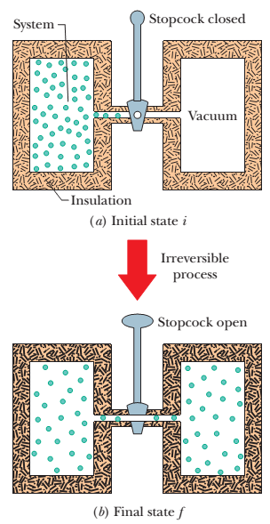
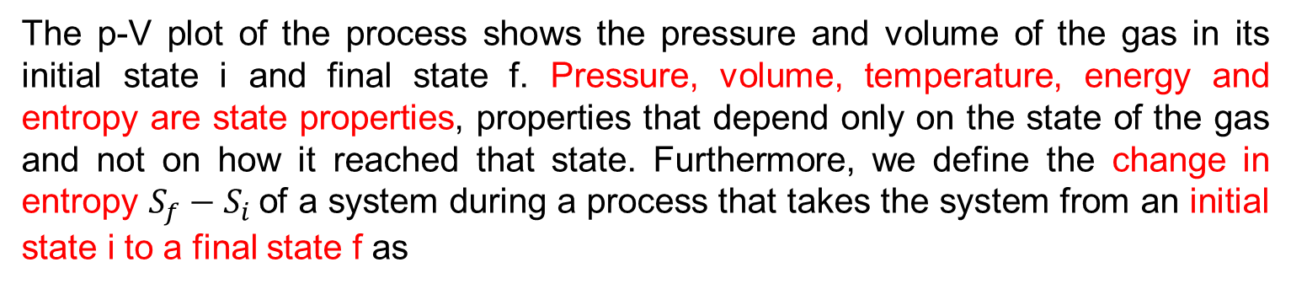
20-1 Change in entropy:
Irreversible free expansion:
Let’s consider the free expansion of an ideal gas. This is an irreversible process; all the molecules of the gas will never return to the left half of the container.
The p-V plot of the process shows the pressure and volume of the gas in its initial state i and final state f. Pressure, volume, temperature, energy and entropy are state properties, properties that depend only on the state of the gas and not on how it reached that state. Furthermore, we define the change in entropy $S_{f}−S_{i}$of a system during a process that takes the system from an initial state i to a final state f as
$$∆S=S_{f} −S_{i}=\int_{i}^{f}{\frac{dQ}{T}}$$
Here Q is the energy transferred as heat to or from the system during the process, and T is the temperature of the system in kelvins. Thus, an entropy change depends not only on the energy transferred as heat but also on the temperature at which the transfer takes place. Because T is always positive, the sign of $∆S$ is the same as that of Q. The SI unit for entropy and entropy change is the joule per kelvin.

Slide 10
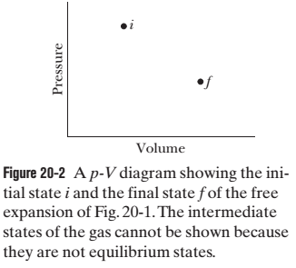
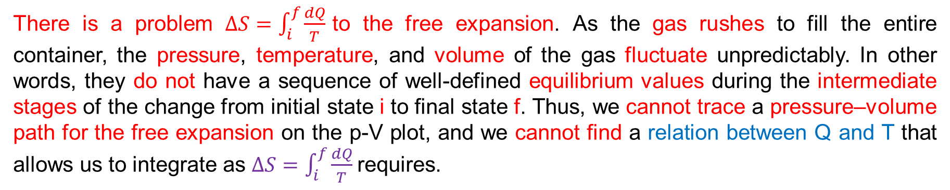
There is a problem $∆S=\int_{i}^{f}{\frac{dQ}{T}}$to the free expansion. As the gas rushes to fill the entire container, the pressure, temperature, and volume of the gas fluctuate unpredictably. In other words, they do not have a sequence of well-defined equilibrium values during the intermediate stages of the change from initial state i to final state f. Thus, we cannot trace a pressure–volume path for the free expansion on the p-V plot, and we cannot find a relation between Q and T that allows us to integrate as $∆S=\int_{i}^{f}{\frac{dQ}{T}}$requires.
However, if entropy is truly a state property, the difference in entropy between states i and f must depend only on those states and not at all on the way the system went from one state to the other. Suppose, then, that we replace the irreversible free expansion with a reversible process that connects states i and f. With a reversible process we can trace a pressure–volume path on a p-V plot, and we can find a relation between Q and T that allows us to use $∆S=\int_{i}^{f}{\frac{dQ}{T}}$to obtain the entropy change.

Slide 11
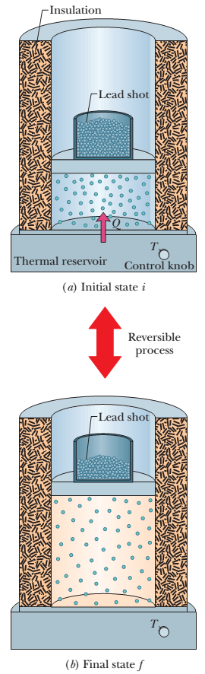
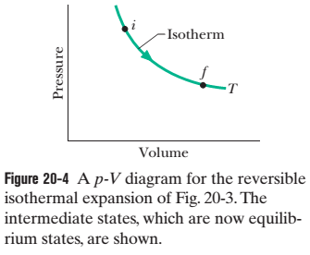
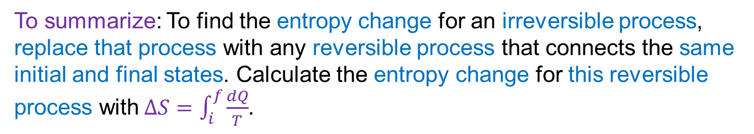
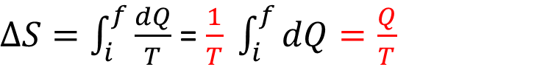
Reversible isothermal expansion:
The reversible isothermal expansion is physically quite different from the irreversible free expansion. However, both processes have the same initial state and the same final state and thus must have the same change in entropy. Because we removed the lead shot slowly, the intermediate states of the gas are equilibrium states, so we can plot them on a p-V diagram (Fig. 20-4).
$∆S=\int_{i}^{f}{\frac{dQ}{T}}$ = $\frac{1}{T} \int_{i}^{f}{dQ=\frac{Q}{T}}$
To keep the temperature T of the gas constant during the isothermal expansion, heat Q must have been energy transferred from the reservoir to the gas. Thus, Q is positive and the entropy of the gas increases during the isothermal process and during the free expansion.
To summarize: To find the entropy change for an irreversible process, replace that process with any reversible process that connects the same initial and final states. Calculate the entropy change for this reversible process with$∆S=\int_{i}^{f}{\frac{dQ}{T}}$.

Slide 12
Chapter 20: Entropy and the second law of thermodynamics
20-1 Second Law of Thermodynamics in terms of Entropy: $∆S≥0$
Reversible process: Let’s check the change in entropy of the enlarged system consisting of gas and reservoir. We can then calculate separately the entropy changes from the following equations.
$∆S=\int_{i}^{f}{\frac{dQ}{T}}$ = $\frac{1}{T} \int_{i}^{f}{dQ=\frac{Q}{T}}$
$$T=constant$$
$${∆S}_{gas}=−\frac{Q}{T}$$
$${∆S}_{res}=+\frac{Q}{T}$$
$∆S=−\frac{Q}{T}$ $+\frac{Q}{T}$= 0

Slide 13
“If a process occurs in a closed system, the entropy of the system increases for irreversible processes $(∆S>0)$ and remains constant for reversible processes$(∆S=0)$. It never decreases.”
That is, $∆S≥0$
In the real world almost, all processes are irreversible to some extent because of friction, turbulence, and other factors, so the entropy of real closed systems undergoing real processes always increases. Processes in which the system’s entropy remains constant are always idealizations.

